Slide 1

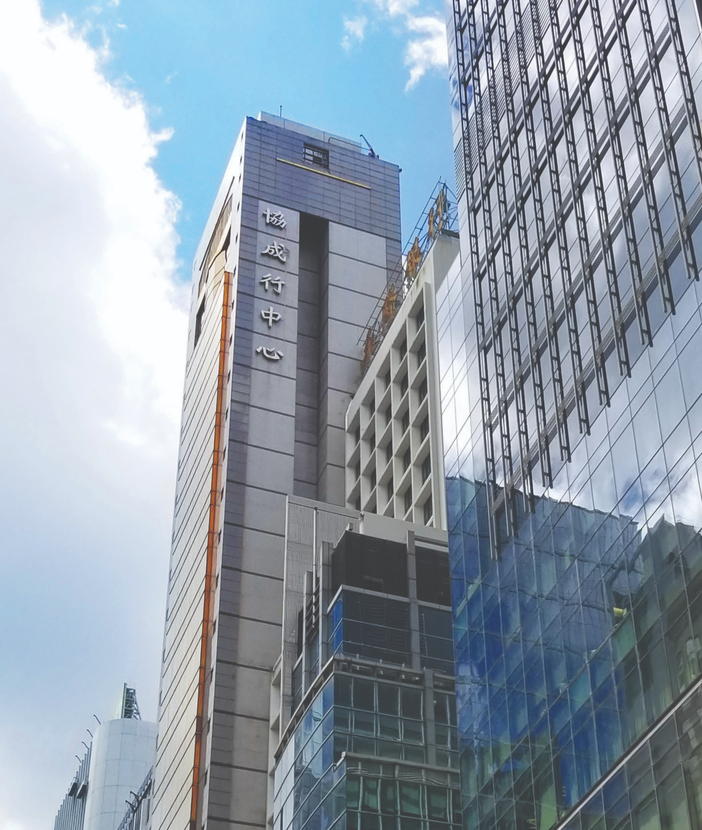



HIP SHING HONG XHS Performance Report - July. 2026
6 August 2026

Slide 2
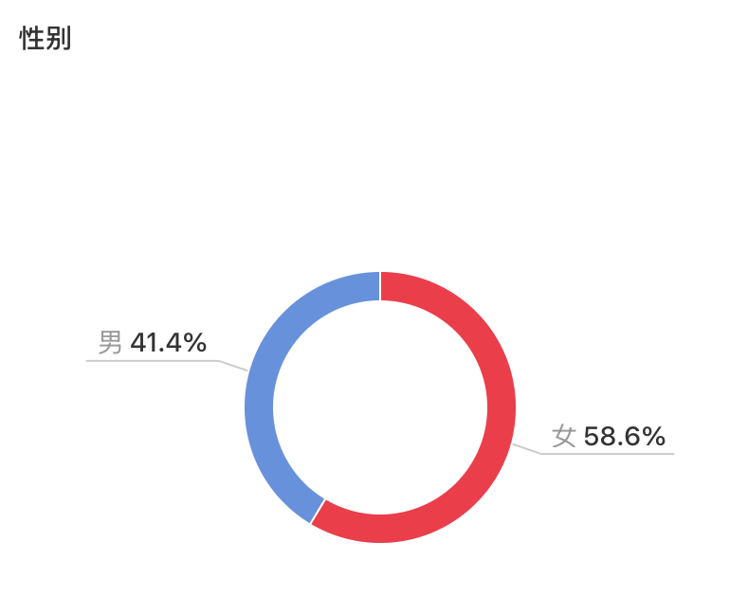
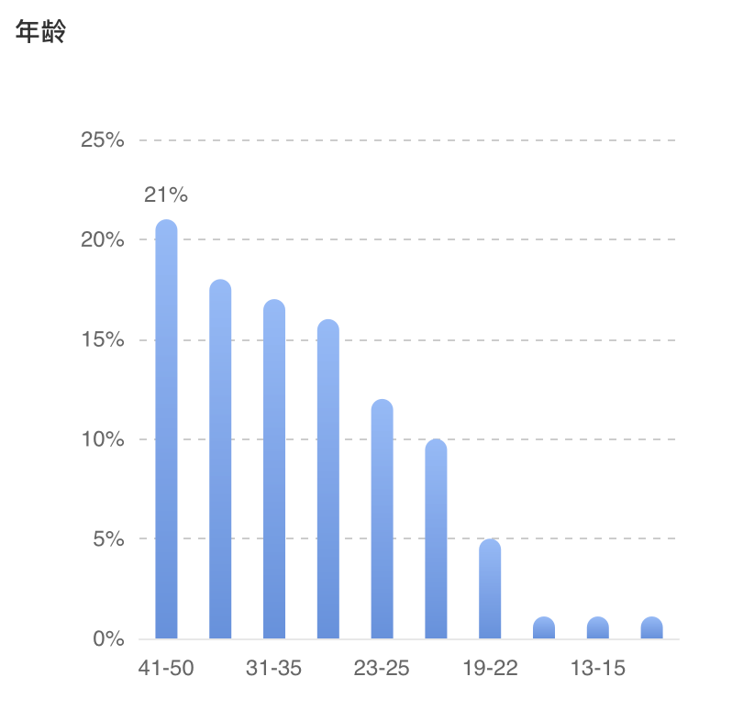
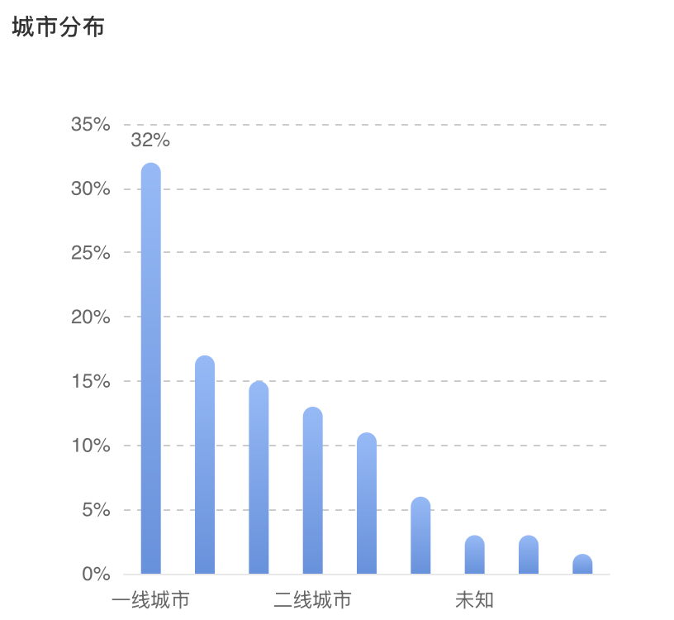
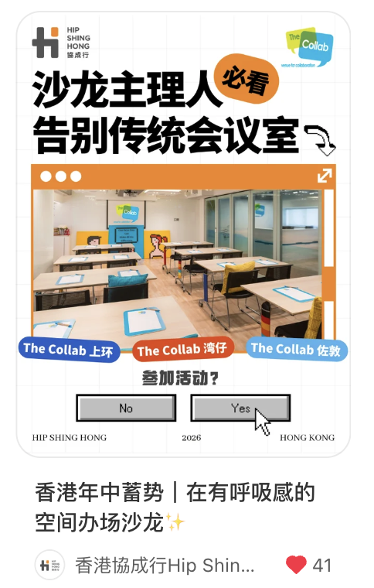
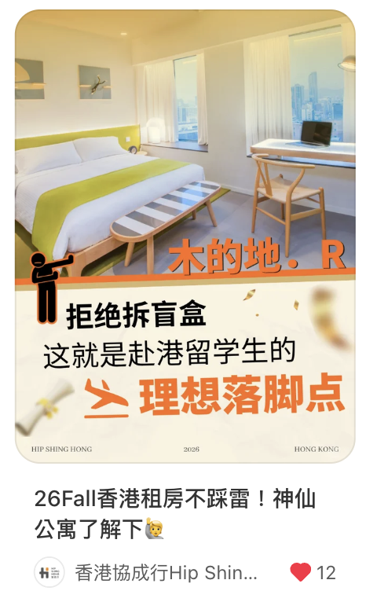
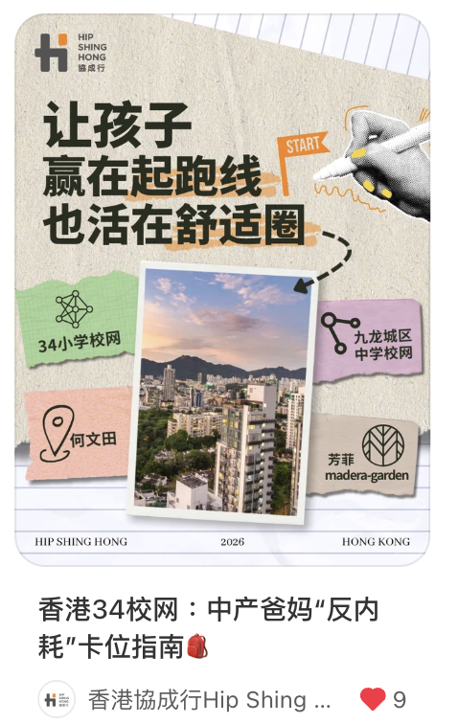
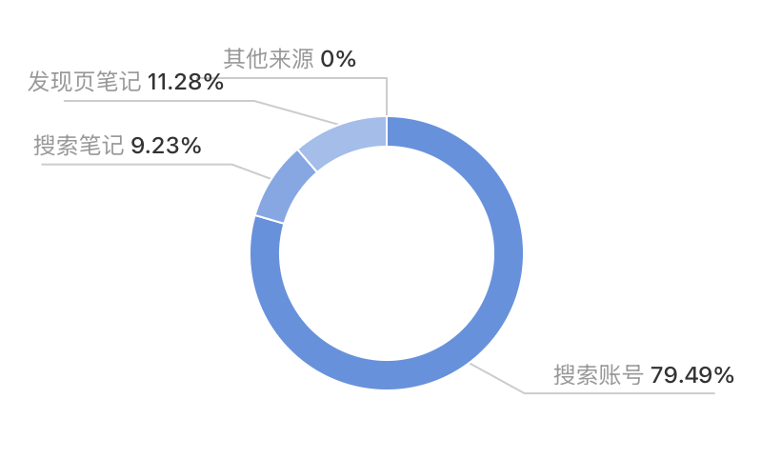
Account Summary
Data overview
Fans feature
Page level statistics | July
Fans Number | 2,154
Fans Net Growth | 128
No. of Post | 3
Total Views | 469
Total Engagement | 98
Total Impressions | 9,802
观众来源
58.6% followers are female, 21%+ aged between 41-50, located in first-tier city.
Our posts are mostly found by users on 1st page recommendations and search page.
This month, we published 3 posts and gained 128 new followers, bringing our total number of followers to 2.1k+.

Slide 3
XHS Post Performance Analysis
The post of “香港年中蓄势｜在有呼吸感的空间办场沙龙✨” achieving the highest engagement of 191, alongside 57 engagements and a gain of 2 new fans.​
“26Fall香港租房不踩雷！神仙公寓了解下🙋” post followed with views and 25 engagements.
XHS Post | Date of Publish | Subject | View | Like | Comment | Share | Saved | Total Engagement | Total Engagement Rate | Fans Increased
1 | 7月 6 | 香港年中蓄势｜在有呼吸感的空间办场沙龙✨ | 191 | 40 | 2 | 0 | 15 | 57 | 29.84% | 2
2 | 7月 14 | 26Fall香港租房不踩雷！神仙公寓了解下🙋 | 202 | 11 | 4 | 2 | 8 | 25 | 12.38% | 2
3 | 7月 31 | 香港34校网：中产爸妈“反内耗”卡位指南🎒 | 76 | 9 | 3 | 0 | 4 | 16 | 21.05% | 0
July total |  |  | 469 | 60 | 9 | 2 | 27 | 98 | 20.90% | 4

Slide 4
July. Media-buy Performance - Post Boosting
聚光
“香港太子这片教育蓝海有多“香”？”, achieving an overall CPC of just 2.09 RMB​ and a total engagement of 70 engagement at a minimal total cost.
XHS Subject | Period | Objectives | Cost￥ | Impressions | Clicks | Likes | Comment | Saved | Follow | Share | Total Engagement | CTR | CPC ¥ | CPM ¥
香港年中蓄势｜在有呼吸感的空间办场沙龙✨ | 7.6-7.8 7.25-7.26 | 全站智投-互动量 | 262.17 | 1,472 | 53 | 23 | 0 | 4 | 2 | 0 | 29 | 3.60% | 4.95 | 178.10
26Fall香港租房不踩雷！神仙公寓了解下🙋 | / | / | / | / | / | / | / | / | / | / | / | / | / | /
香港34校网：中产爸妈“反内耗”卡位指南🎒 | / | / | / | / | / | / | / | / | / | / | / | / | / | /
香港太子这片教育蓝海有多“香”？ | 7.3-7.6 | 全站智投-互动量 | 260.06 | 3,814 | 197 | 18 | 0 | 8 | 7 | 8 | 41 | 5.17% | 1.32 | 68.19
July Total |  |  | 522.23 | 5,286 | 250 | 41 | 0 | 12 | 9 | 8 | 70 | 4.73% | 2.09 | 98.79
HKD Total + 20% Service fee |  |  | $726.94
Exchange rate: 1RMB = 1.16 HKD

Slide 5
July. Media-buy Performance - Page Boosting
Exchange rate: 1RMB = 1.16 HKD
薯条
In July, we executed a hybrid media-buy strategy utilizing both XHS Spark (聚光) and Boost (薯条) to drive post likes and saves.
XHS Subject | Period | Objectives | Cost￥ | Impressions | Clicks | Likes | Comment | Saved | Follow | Homepage Views | Direct Messages | CTR | CPC ¥ | CPM ¥
香港年中蓄势｜在有呼吸感的空间办场沙龙✨ | 7/7 | 点赞收藏量 | 300 | 2,225 | 68 | 24 | 1 | 8 | 1 | 8 | 1 | 3.06% | 4.41 | 134.83
26Fall香港租房不踩雷！神仙公寓了解下🙋 | 7/15 | 点赞收藏量 | 150 | 835 | 22 | 0 | 1 | 1 | 1 | 4 | 1 | 2.63% | 6.82 | 179.64
26Fall香港租房不踩雷！神仙公寓了解下🙋 | 7/23 | 点赞收藏量 | 150 | 1,488 | 16 | 1 | 0 | 0 | 0 | 0 | 0 | 1.08% | 9.38 | 100.81
香港太子这片教育蓝海有多“香” | 7/29 | 粉丝关注量 | 300 | 4,036 | 285 | 5 | 2 | 4 | 19 | 53 | 3 | 7.06% | 1.05 | 74.33
当AI接管了逻辑，为什么我们仍需见一面？
马年办活动不踩雷⚡香港三地场地任选
从工业区到艺术核心，在黄竹坑偶遇灵感
在中环「黄金边界」寻找你的事业坐标
1分钟香港站！中环宝藏“效率坐标”🚀 | 7/29 | 点赞收藏量 | 300 | 2,604 | 226 | 53 | 0 | 29 | 3 | 11 | 0 | 8.68% | 1.33 | 115.21
26Fall香港租房不踩雷！神仙公寓了解下🙋 | 7/29 | 点赞收藏量 | 200 | 880 | 28 | 3 | 0 | 1 | 1 | 5 | 0 | 3.18% | 7.14 | 227.27
26Fall香港租房不踩雷！神仙公寓了解下🙋 | 7/30 | 点赞收藏量 | 150 | 975 | 75 | 31 | 0 | 10 | 0 | 6 | 0 | 7.69% | 2.00 | 153.85
1分钟香港站！中环宝藏“效率坐标”🚀
香港CBD2！观塘24小时不打烊创意基地💡
港岛选址秘籍：看懂人流量，开店成功一半
July Total |  |  | 1,550 | 13,043 | 720 | 117 | 4 | 53 | 25 | 87 | 5 | 5.52% | 2.15 | 118.84
HKD Total + 20% Service fee |  |  | $2,157.60

Slide 6
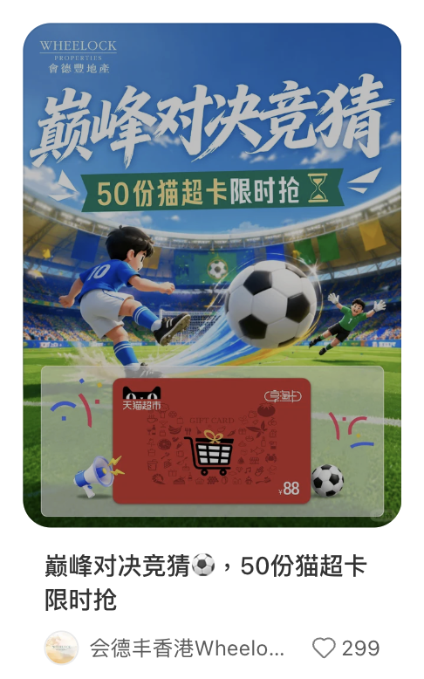
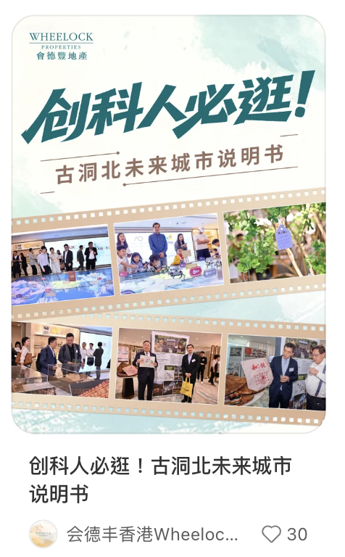
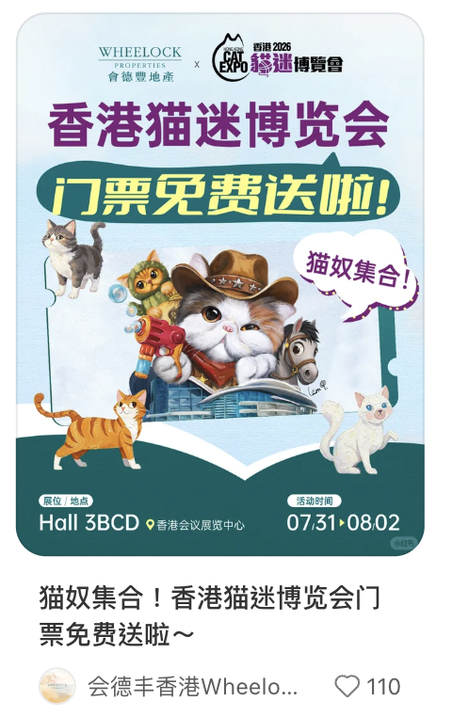
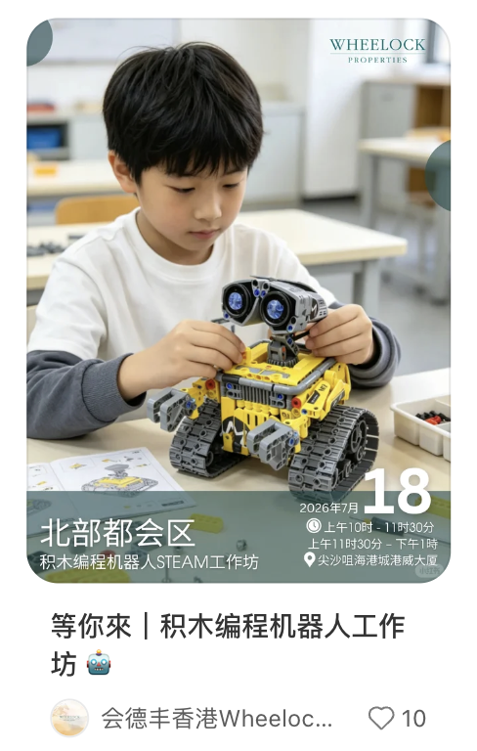
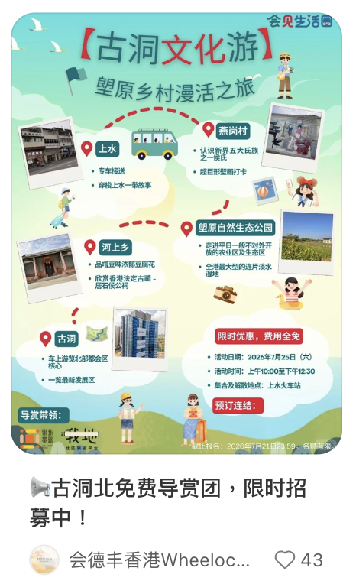
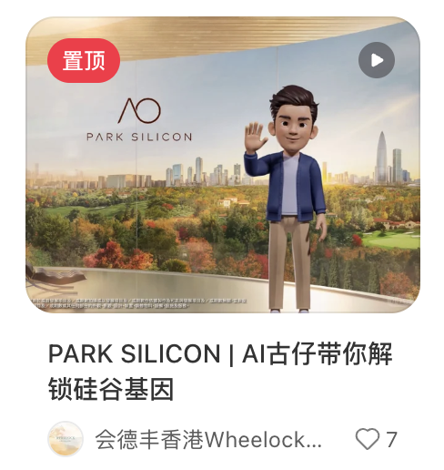
Competitors Analysis
会德丰香港WheelockLiving
Account overview in July. :
Total posted 6 feeds, including 5 text and 1 video feeds
Content Pillar：Experiential Living & Local Engagement & Offers
Top1 post analysis-新城35周年🎵100张音乐会门票免费送
The post performs exceptionally well by leveraging the 35th anniversary milestone​ and a high-value free concert ticket giveaway​ — featuring popular artists like Stephy Tang — which effectively captures user attention and keeps the brand top-of-mind in a festive, engaging manner.
July Top 2&3 content:
“猫奴集合！香港猫迷博览会门票免费送啦～” post performs well by leveraging the mass appeal of 'Hong Kong Cat Fanciers Expo 2026' and a 'Western Cowboy Cat' themed free ticket giveaway, using a native XHS giveaway format that lowers participation barriers and effectively boosts brand affection among pet-loving audiences.
“📢古洞北免费导赏团，限时招募中！” performs well by recasting Kwu Tung North as a "Ghibli-style summer" eco-escape, pairing a free guided tour with scarcity and tangible rewards to lower participation barriers and drive strong save-and-comment engagement.

Slide 7
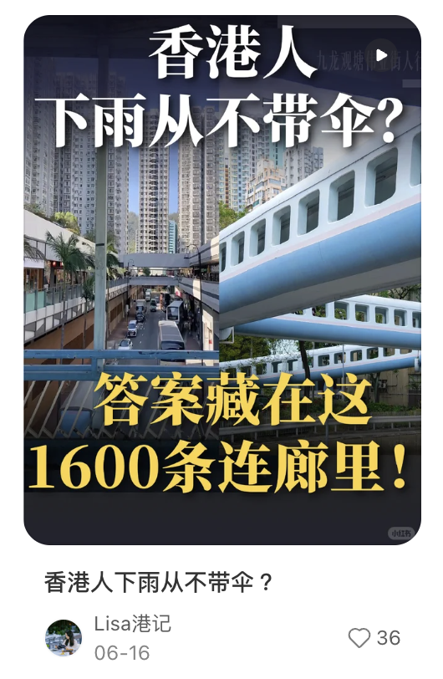
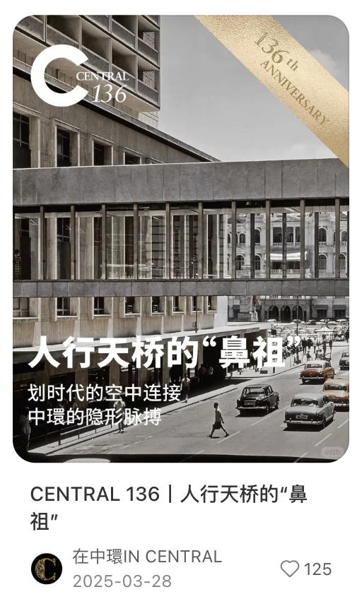
Learning & Suggestions
Content Strategy Recommendations：
Efficiency Workplace Experience Strategy
Shift focus from individual properties to universal worker pain points—like weather-disrupted commutes or inefficient transit between work and social life. Position Hip Shing Hong’s portfolio as a system that eliminates these frictions, building emotional resonance with efficiency-driven decision-makers.
e.g.​ Promote Hip Shing Hong Centre by highlighting its covered walkway network in Central that workers can stay dry from MTR to desk to after-work drinks—turning infrastructure into an aspirational lifestyle of seamless productivity.

Slide 8
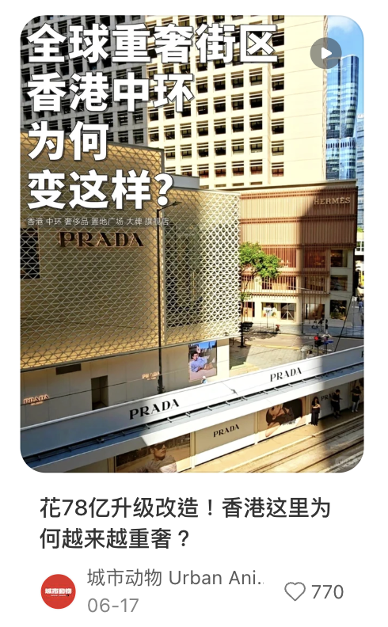
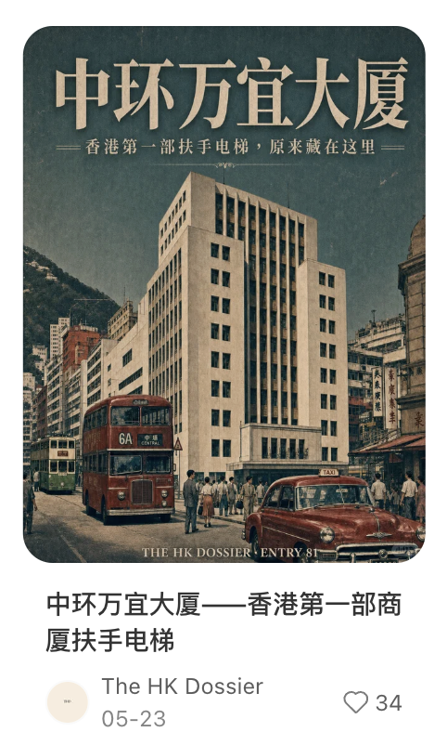
Learning & Suggestions
Content Strategy Recommendations：
Hip Shing Hong Archives Strategy
Leverage the rich history of Hip Shing Hong and its properties as a content pillar. Uncover hidden historical facts, architectural details, and the background stories (e.g. Kwun Tong’s urban renewal). Examples include trivia like "How many MTR exits does this Central footbridge connect?" or "Why Madera Hotel's name has Portuguese roots." Source materials from internal archives, Wikipedia, and old newspapers, which builds brand depth and nostalgia.

Slide 9
Thank You
Contact: info@dichat.hk

